Slide 1
ModEDI
An Extendable Software Architecture for Examining the Effects of Developmental Interactions on Evolutionary Trajectories
Elizabeth Brooks
Dept. of Computer Science
Western Washington University
Graham Roberts
Dept. of Computer Science
Western Washington University
Alison Scoville
Dept. of Biology
Central Washington University
Filip Jagodzinski
Dept. of Computer Science
Western Washington University
Notes:
Hello I am Elizabeth Brooks…. Today we are presenting ModEDI….. This software architecture may be used to test evolutionary-developmental and quantitative genetic hypotheses.

Slide 2
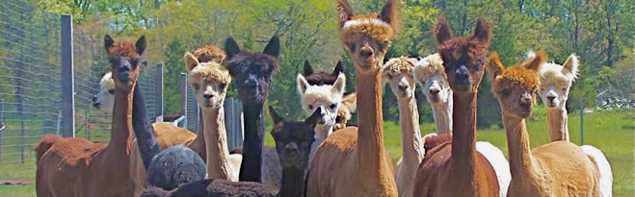
Background - Quantitative Genetics
http://www.bio.miami.edu/dana/250/250SS15_2print.html
Notes:
Quantitative genetics is the study of complex biological traits, or traits controlled by more than one gene. A primary goal of quantitative genetics studies is the development of computational models for predicting the evolution of such traits in response to selection.

Slide 3
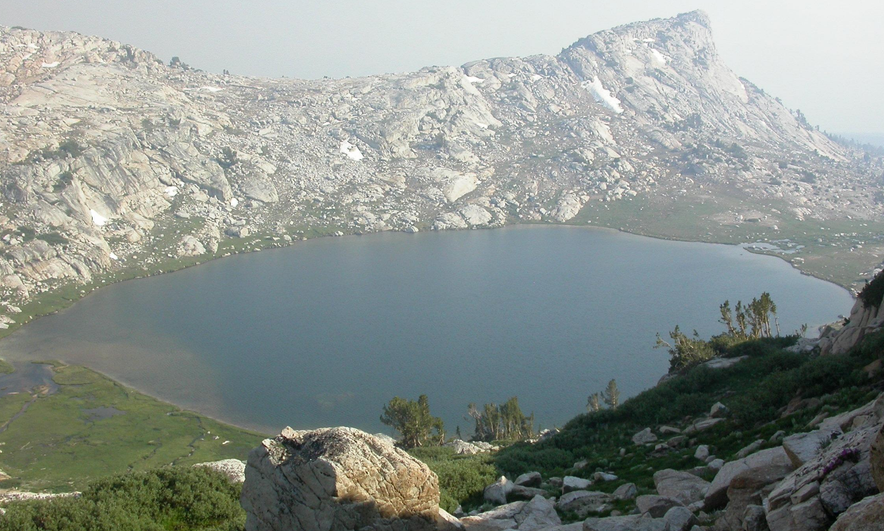
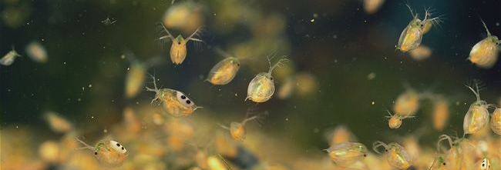
Case Study - Models for Daphnia
http://andynewman.org/html/daphnia_water_flea.html
http://www.archive.org
Notes:
To investigate these complex genetic dynamics, we have developed models of quantitative trait evolution for Daphnia melanica. Daphnia are a freshwater microcrustacean, commonly found in high alpine lakes of the Sierra Nevada.

Slide 4
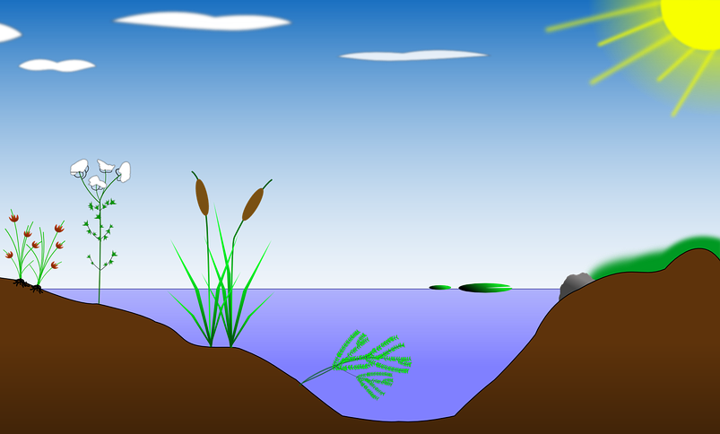
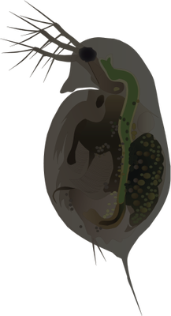


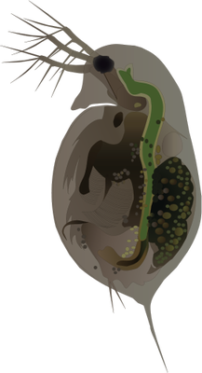

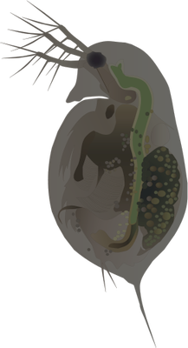

Nonlinear Developmental Interactions (NDI)
http://ian.umces.edu/imagelibrary/displayimage-4387.html
https://pixabay.com/en/biotope-lake-pond-habitat-reed-154853/
Notes:
In these lakes, Daphnia will swim near the water’s surface, receiving a high amount of UV radiation and be dark in pigmentation.

Slide 5
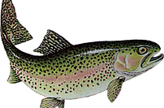
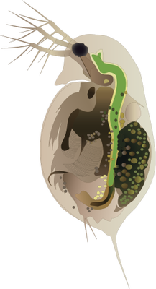
Nonlinear Developmental Interactions (NDI)
http://www.smoka.co.uk/trout
Notes:
When fish predators are introduced into one of these lakes, usually for sport fishing, the Daphnia will migrate lower in the water column to avoid them. By being lower in the water column, the Daphnia receive less UV radiation and are lighter in pigmentation.

Slide 6
Central Concept - Fitness Surface
https://commons.wikimedia.org/wiki/File:Visualization_of_a_population_evolving_in_a_static_fitness_landscape.gif
Notes:
Quantitative genetic models recognize that two elements are needed to predict the evolution of traits due to selection: the strength and direction of selection, and the availability of heritable genetic variation. The strength and direction of selection is captured by the individual fitness surface, which describes the expected reproductive success of an individual as a function of its trait values.

Slide 7
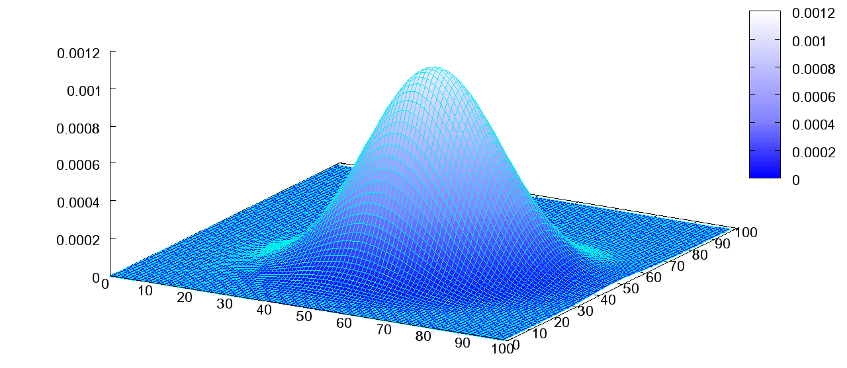
Surface Distribution - Bivariate Normal
x and y are normally distributed values
The sum of x and y form the bivariate normal distribution
x + y
y
x
N(<x>,σₓ)+ N(<y>,σᵧ)
https://commons.wikimedia.org/wiki/File:Multivariate_Gaussian.png

Slide 8
Surface Distribution - Bivariate Normal
Melanin and DVM are normally distributed trait values
The sum of Melanin and DVM form the bivariate normal distribution
Melanin + DVM
Melanin
DVM

Slide 9
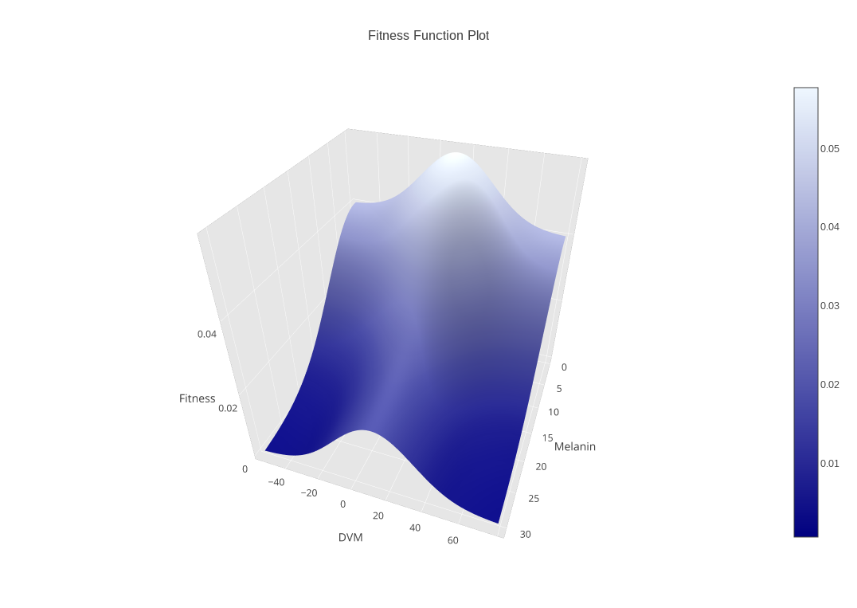
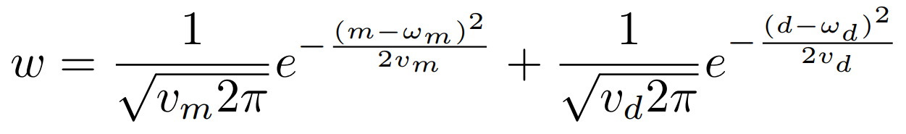
Central Concept - Fitness Surface
Melanin and DVM are normally distributed trait values
The sum of Melanin and DVM form the bivariate normal distribution

Slide 10
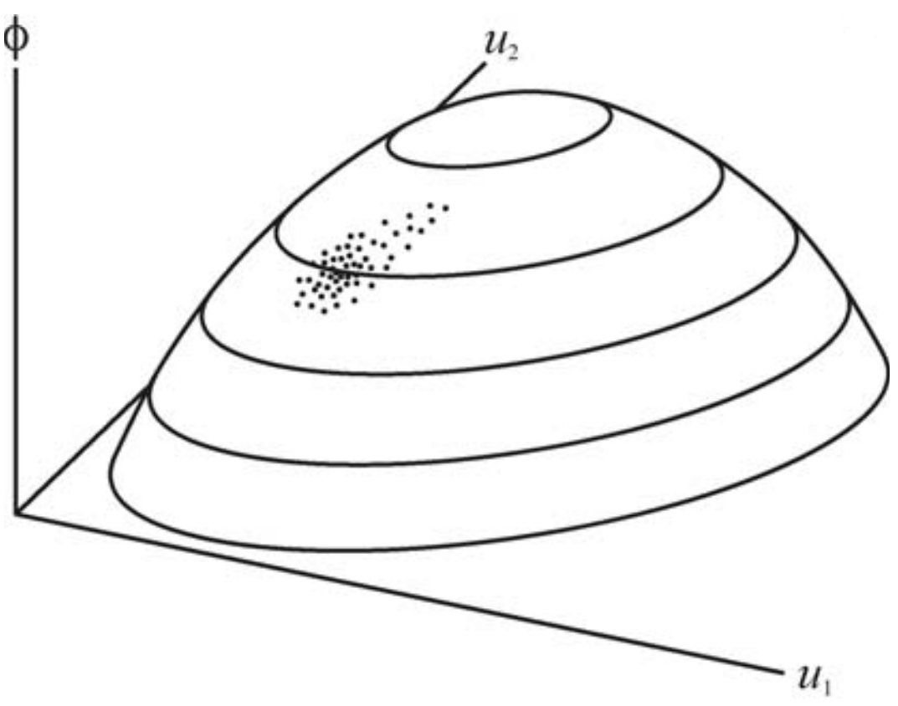
Central Concept - Phenotype Surface
ϕ represents a physical trait
u₁ and u₂ represent underlying genetic factors
http://www.faculty.biol.ttu.edu/rice/rice08b.pdf
Notes:
The phenotype surface is constructed by plotting the value of a phenotype against the values of underlying genetic and environmental factors that interact in its development. (a) A nonlinear phenotype landscape representing a trait, /, as a function of two underlying genetic factors. The cloud of points on the surface represents a population, each point corresponding to an individual.

Slide 11
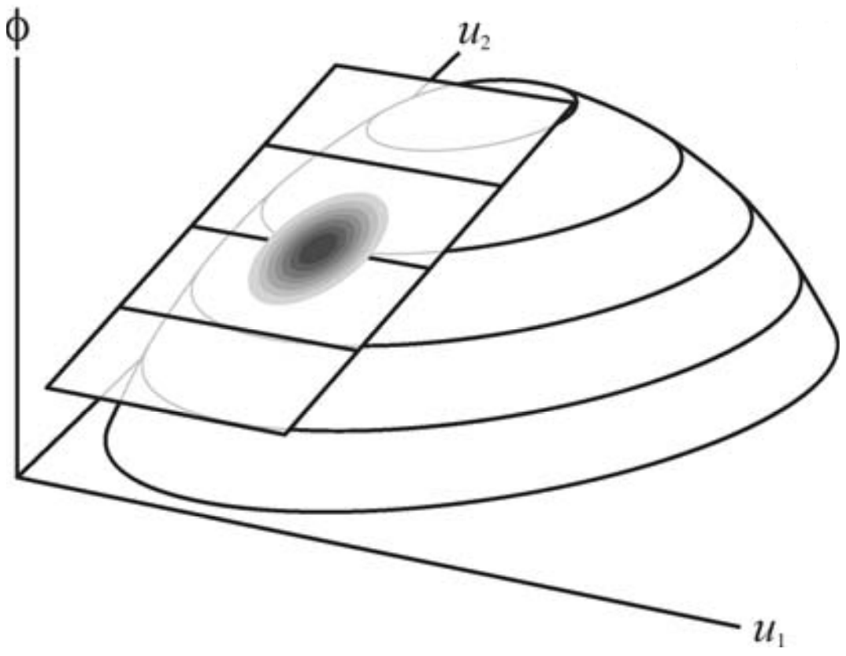
Phenotype Surface vs G-matrix
Phenotype Surface
G-matrix Approximation
Notes:
(b) G-matrix models consider a tangent plane and treat the population as a multivariate normal distribution.

Slide 12
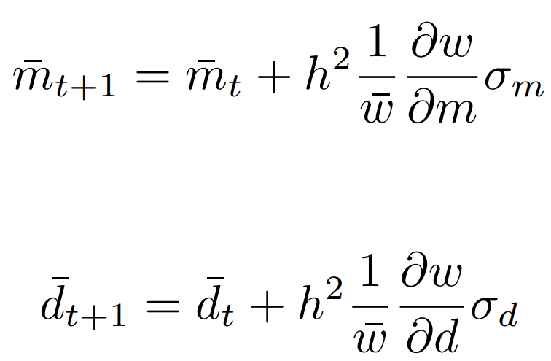
Classic Model - G-matrix
h² is the diagonal values of the heritability matrix
w is the mean population fitness
σ_{d} and σ_{m} are the DVM (d) and Melanin (m) phenotypic variances
Melanin development:
DVM development:
Notes:
The G-Matrix model for Daphnia describes the development of physical traits independently, related only through the fitness surface. A key insight, that developmental processes structure the geometry of the G-matrix, promises to transform our understanding of evolutionary patterns.

Slide 13
Recall - Phenotype Surface
ϕ represents a physical trait
u₁ and u₂ represent underlying genetic factors
Notes:
(a) A nonlinear phenotype landscape representing a trait, /, as a function of two underlying genetic factors. The cloud of points on the surface represents a population, each point corresponding to an individual.

Slide 14
Tanning Model - Phenotype Surface
ϕ represents a physical trait, Melanin
u₁ and u₂ represent underlying genetic factors
Melanin

Slide 15
Tanning Model - Phenotype Surface
ϕ represents a physical trait, Melanin
u₁ and u₂ represent underlying genetic factors, Average Daytime Depth and Sensitivity to UVB
Sensitivity to UVB
Melanin
Average Daytime Depth

Slide 16
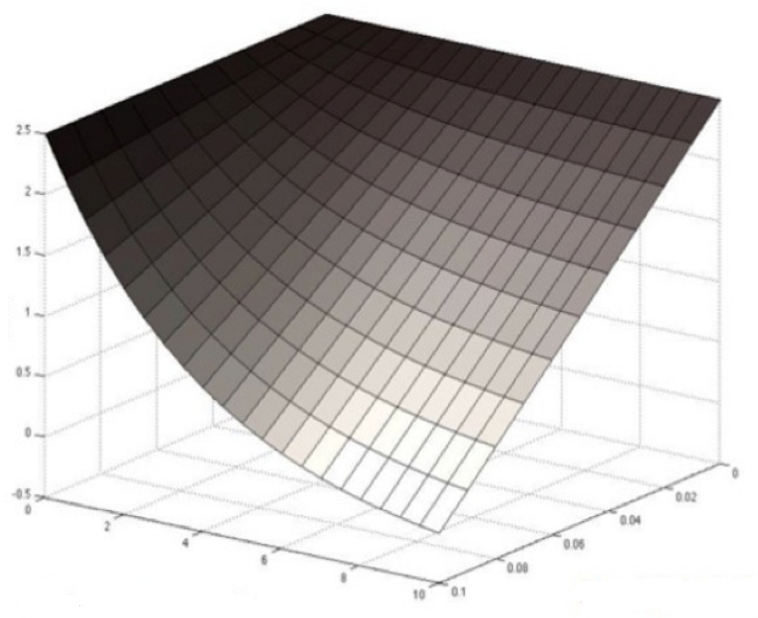
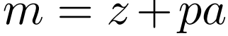
Tanning Model - Phenotype Surface
z is the concentration of melanin produced in response to UV light
p is the slope of the reaction norm indicating sensitivity to UVB
a is the change in UVB exposure
Melanin
Average Daytime Depth
Sensitivity to UVB
Notes:
Here is an example of the phenotype surface for Daphnia, as described by this linear function for the production of melanin with respect to these underlying genetic factors.

Slide 17
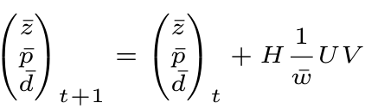
Tanning Model - NDI
Melanin production:
d is DVM, treated as a quantitative genetic trait
H is the heritability matrix
U represents the change in DVM, simplified
V represents the change in Melanin, simplified
Development of genetic factors:

Slide 18
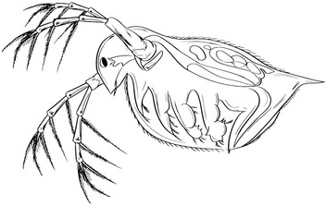
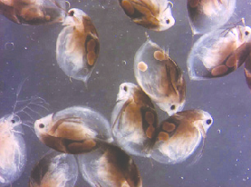
Daphnia Species Objects
Daphnia Blueprint
States represent phenotypic traits, DVM and Melanin
Behaviours represent the phenotypic functions of our models for Daphnia, Classic and Tanning
Daphnia Objects
Daphnia melanica
- DVM: int - Melanin: int
+ setDVM + setMelanin
https://t3.ftcdn.net/jpg/00/47/53/14/240_F_47531414_8Vj6iYmdowUNtgFrxmmtgPdT8gRTzCdy.jpg
https://www.researchgate.net/figure/51073279_fig5_Fig-5-Pigmented-zooplankton-Melanised-Daphnia-umbra-left-and-Eudiaptomus-graciloides
Notes:
The object-oriented software architecture of ModEDI describes the evolution of physical traits of Daphnia by describing a blueprint for objects of individual daphnia, where the states represent the phenotypic traits Melanin and DVM, and the behaviours of the Daphnia object describe the development of these states.

Slide 19
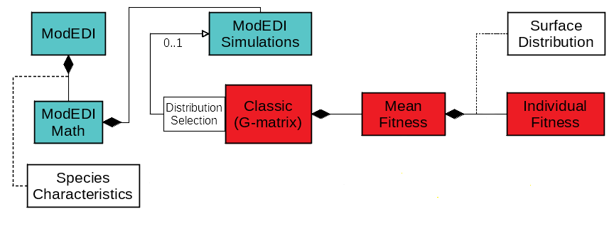
Software Architecture - Classic Model
Notes:
Evolutionary trajectories of physical traits are projected by the Classic model by first retrieving the input initial values stored in the Species Characteristics interface, and qualified by the probability distribution selected by the user. The fitness surface is described by the Mean Fitness class by simulating populations of individual Daphnia with the Individual Fitness class, following the distribution specified by the user and described by the Surface Distribution interface.

Slide 20
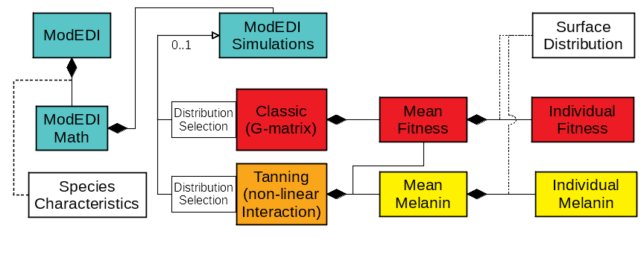
Software Architecture - Tanning Model
Notes:
The Tanning model, however, projects the evolution of physical traits by drawing from the phenotype surface calculated by the Mean Melanin class. The phenotype surface is described by the function for melanin production in the Individual Melanin class, with the user specified distribution described by the Surface Distribution interface.

Slide 21
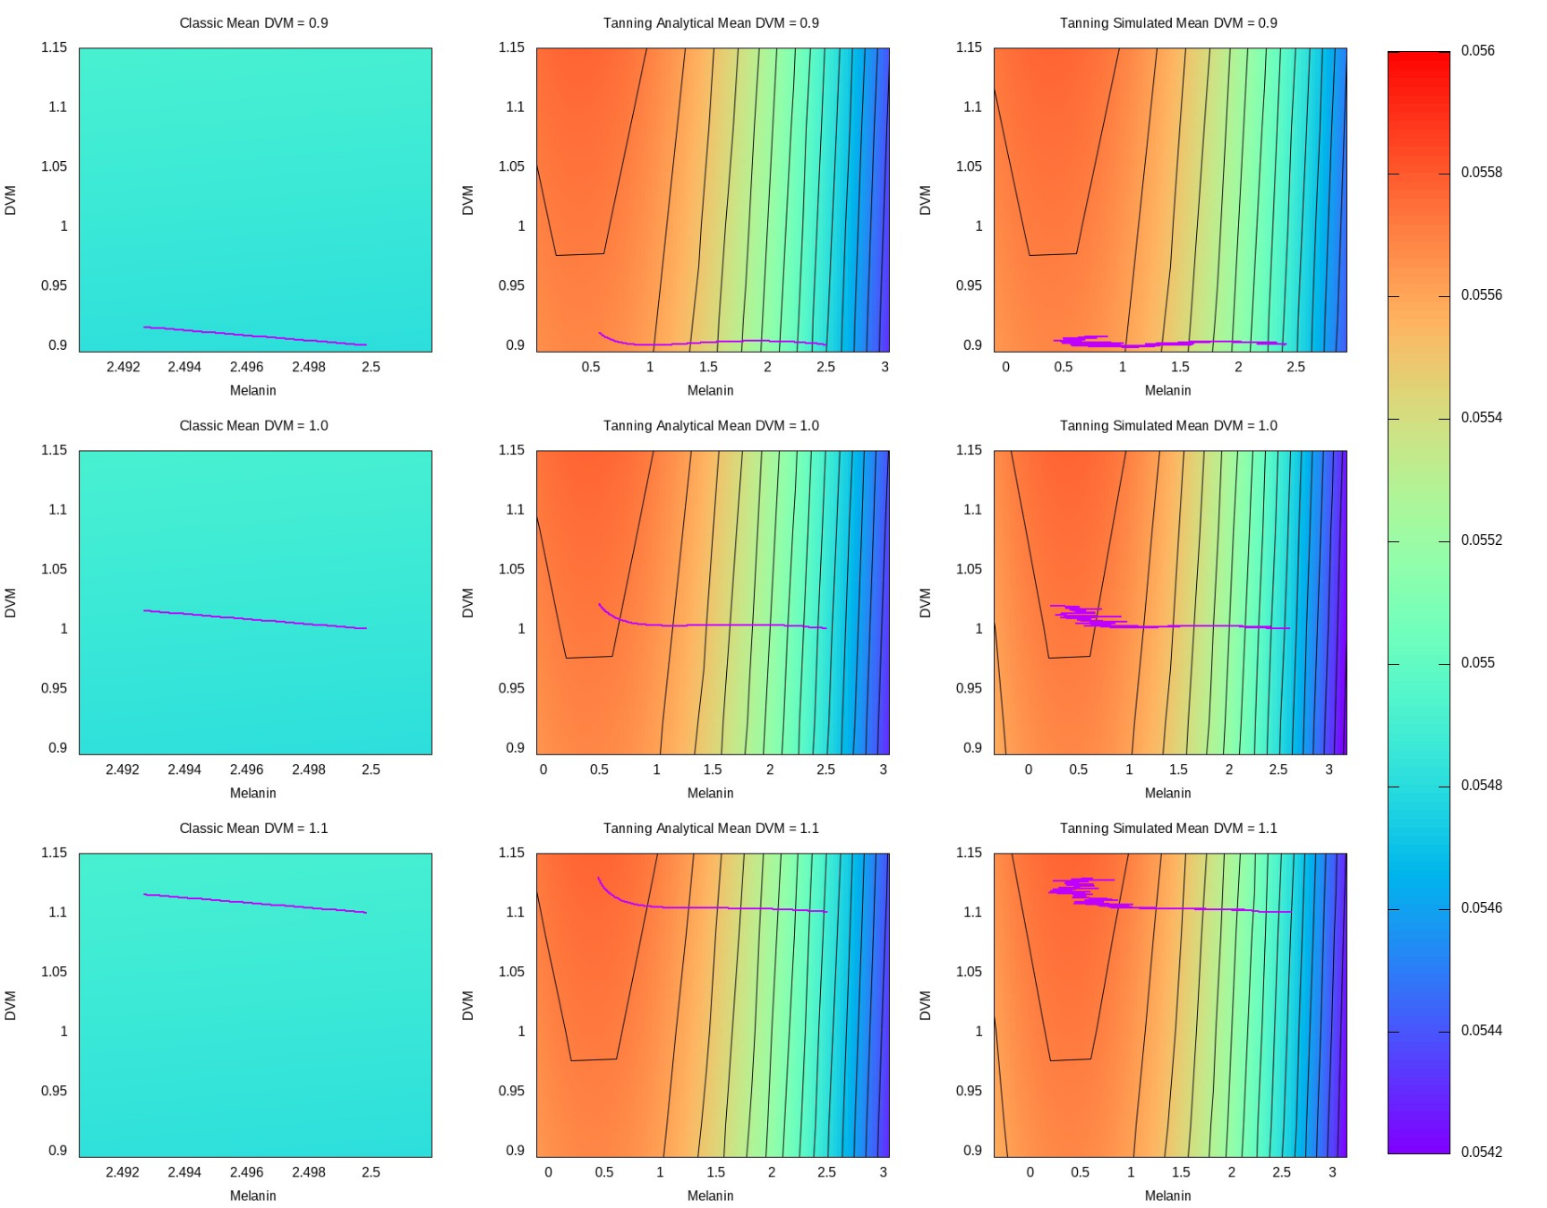
Initial DVM Parameter Sweep
Sweep conclusions:
Closer and Farther
Little change in trajectory
Classic model evolves more slowly than Tanning
Notes:
Values for UVB dose at the water surface and attenuation coefficient were obtained from Sequoia National Park in the Sierra Nevada Range. Values specific to Daphnia were obtained from empirical studies. Starting trait values match mean values from populations that have not been subject to fish predation. Fitness optima were estimated from mean trait values in populations that have been subject to selection by human-introduced fish predators for approximately 100 years. Variances of the fitness surface and heritability were chosen to represent plausible values.

Slide 22
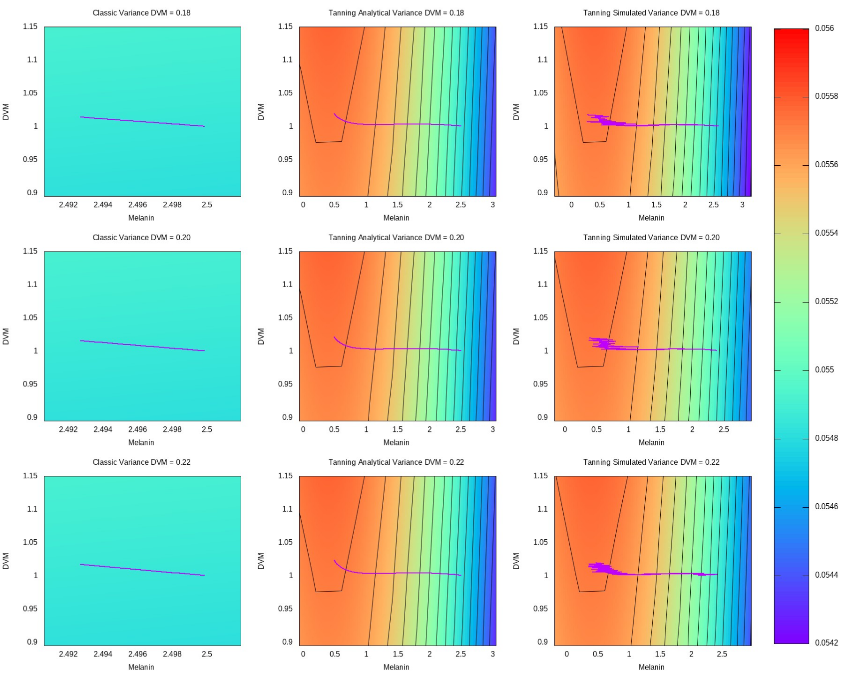
Variance DVM Parameter Sweep
Sweep conclusion:
Reasonable changes little effect
Classic model evolves more slowly than Tanning
Tanning model with simulation most reactive
Notes:
Values for UVB dose at the water surface and attenuation coefficient were obtained from Sequoia National Park in the Sierra Nevada Range. Values specific to Daphnia were obtained from empirical studies. Starting trait values match mean values from populations that have not been subject to fish predation. Fitness optima were estimated from mean trait values in populations that have been subject to selection by human-introduced fish predators for approximately 100 years. Variances of the fitness surface and heritability were chosen to represent plausible values.

Slide 23
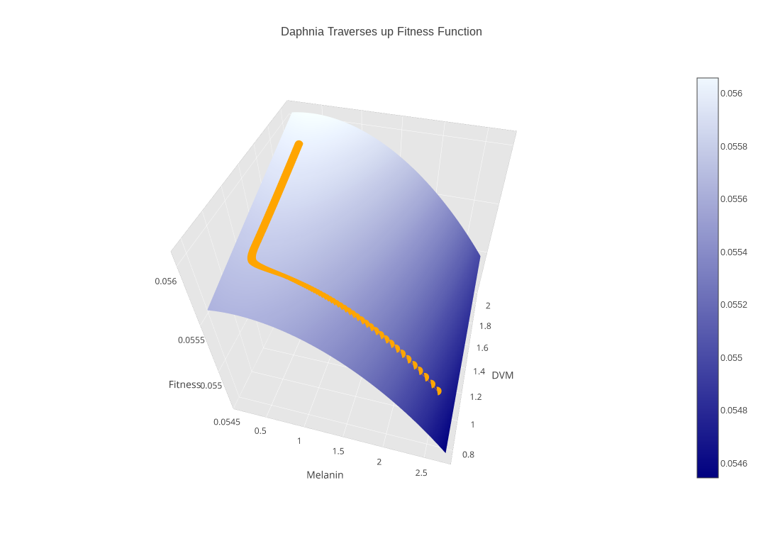
Daphnia Case Study - Results
Melanin evolves relatively quickly
Trajectories are generally the same for different parameters
Notes:
Values for UVB dose at the water surface and attenuation coefficient were obtained from Sequoia National Park in the Sierra Nevada Range. Values specific to Daphnia were obtained from empirical studies. Starting trait values match mean values from populations that have not been subject to fish predation. Fitness optima were estimated from mean trait values in populations that have been subject to selection by human-introduced fish predators for approximately 100 years. Variances of the fitness surface and heritability were chosen to represent plausible values.

Slide 24
Conclusions
Classic model evolves more slowly than Tanning model
ModEDI predictions resistant to small parameter changes
Modeled Daphnia populations evolve towards trait optima
ModEDI as a powerful tool for analyzing the effects of multiple genes on physical traits

Slide 25
Future Work
Increase generalization
Add support for other fitness distributions and organisms
Make available an easy to use interface

Slide 26
Acknowledgements
CWU Science Honors Research Program, CWU
College of the Sciences and Engineering, WWU
Notes:
We would like to thank...

